Slide 1
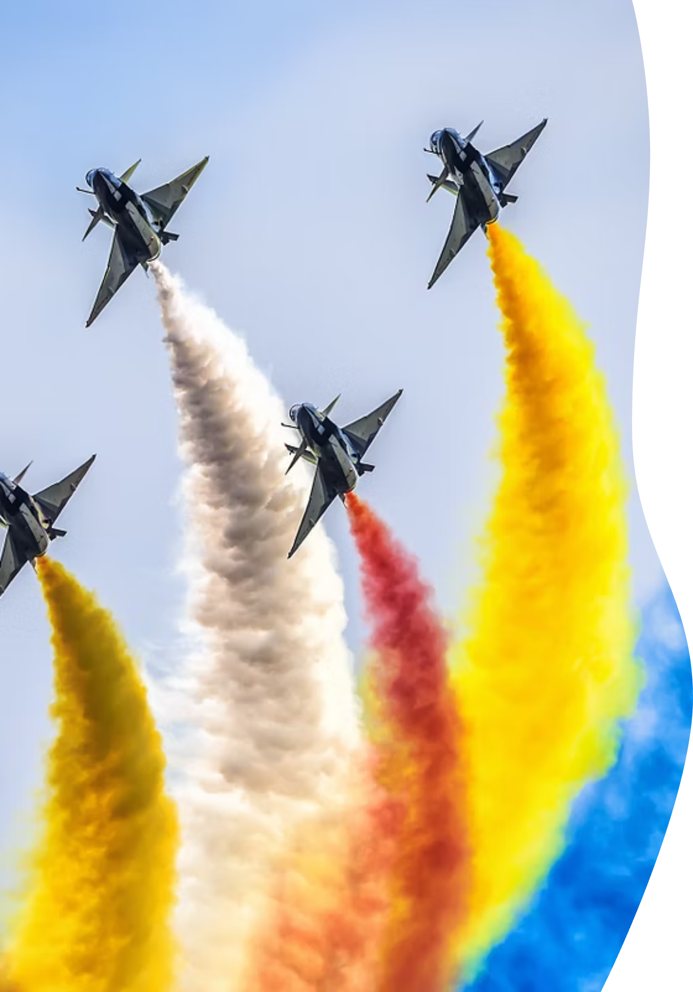
What Are Air Shows?
An Exciting Display of Aviation Skill and History

Slide 2
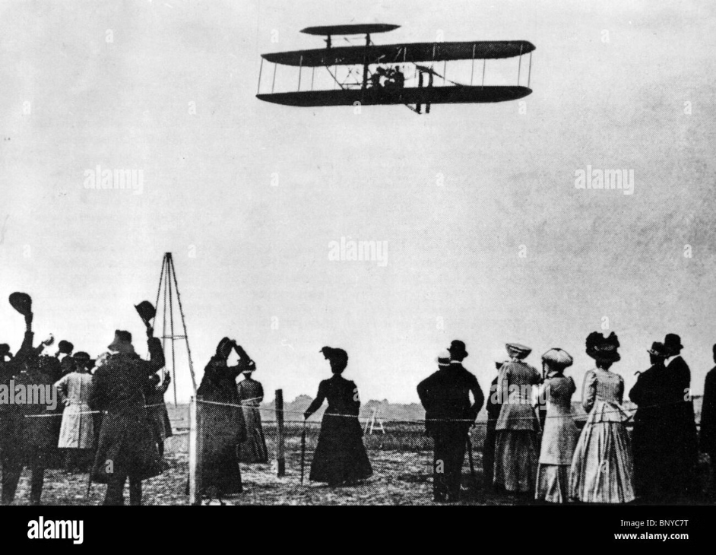
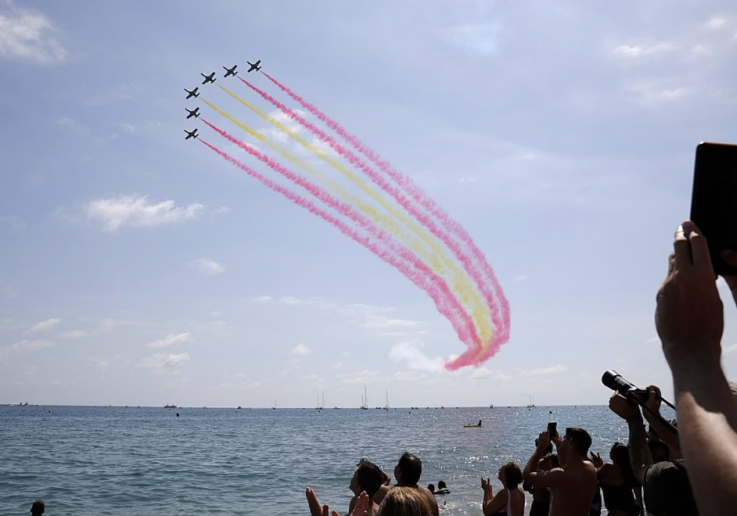
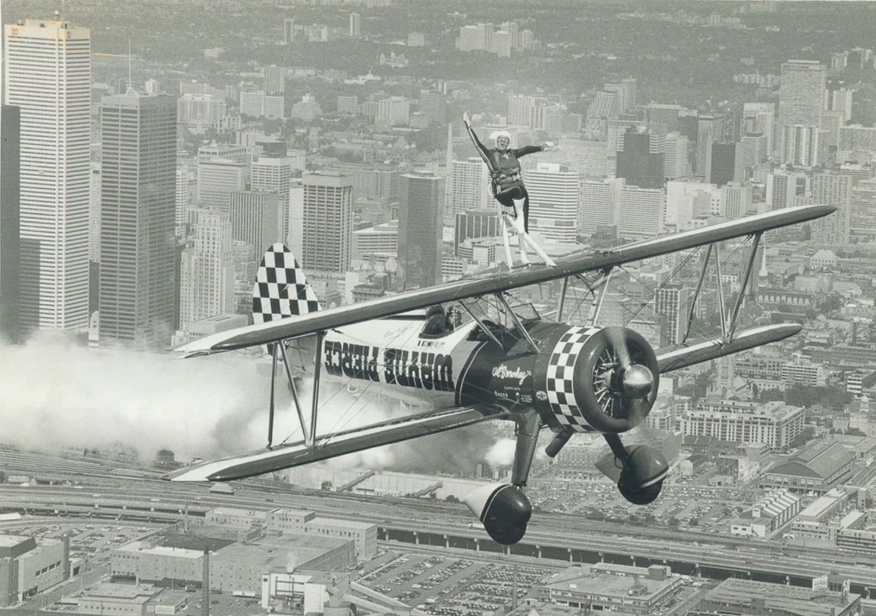
Introduction & History of Air Shows
Global Exhibitions
Historic Beginnings
Daredevil Era
Public events showcasing diverse aircraft and thrilling demonstrations.
First major show: Grande Semaine d'Aviation, Reims, France (1909).
Early pilots performed stunts like wing walking and loops, captivating audiences and popularizing aviation.

Slide 3
Types of Air Shows
Civilian Airshows
Commercial aircraft
Organized by: Private Organization or flying club
Include stunt flying,aerobatics and Entertainment
Example:Red Bull Air Race
Organized by: Aviation compines
Focus on: Aircraft exhibitions, business deals
Example: Dubai Airshow, Paris Airshow
Military Airshows
Vintage/Historica Airshows
Organized by: Air forces or defense ministries of a country
Focus on: Fighter jets, helicopters, military technology
Organized by:historical aviation societies
Focus on:demonstrating early aviation history
Example: Duxford Air Festival (UK)

Slide 4

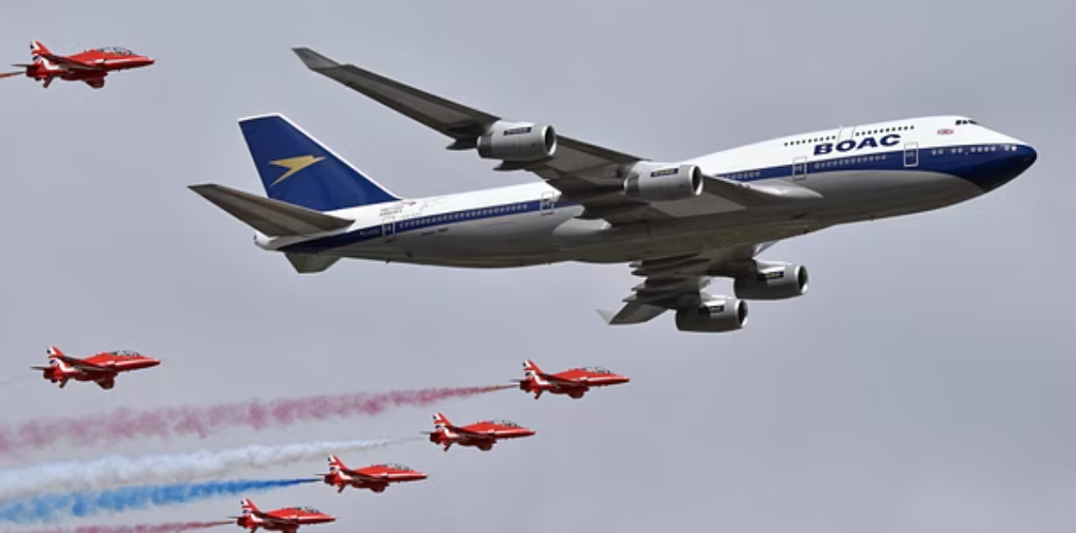
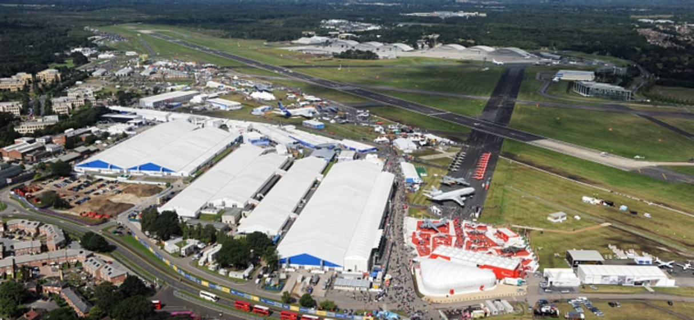
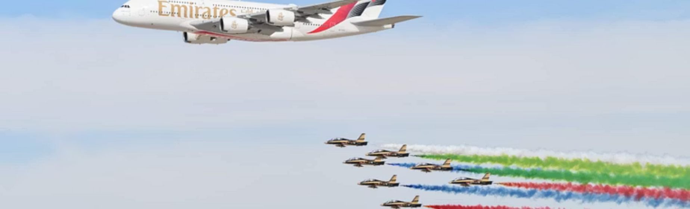

Famous Air Shows Around the World
EAA AirVenture Oshkosh (USA): Largest by participating aircraft (~10,000 annually).
Royal International Air Tattoo (UK): World's biggest military airshow.
Farnborough International Airshow (UK): Premier aerospace trade event.
Dubai Airshow: Major Middle East aerospace exhibition.
Chicago Air & Water Show: One of the largest free public airshows.

Slide 5
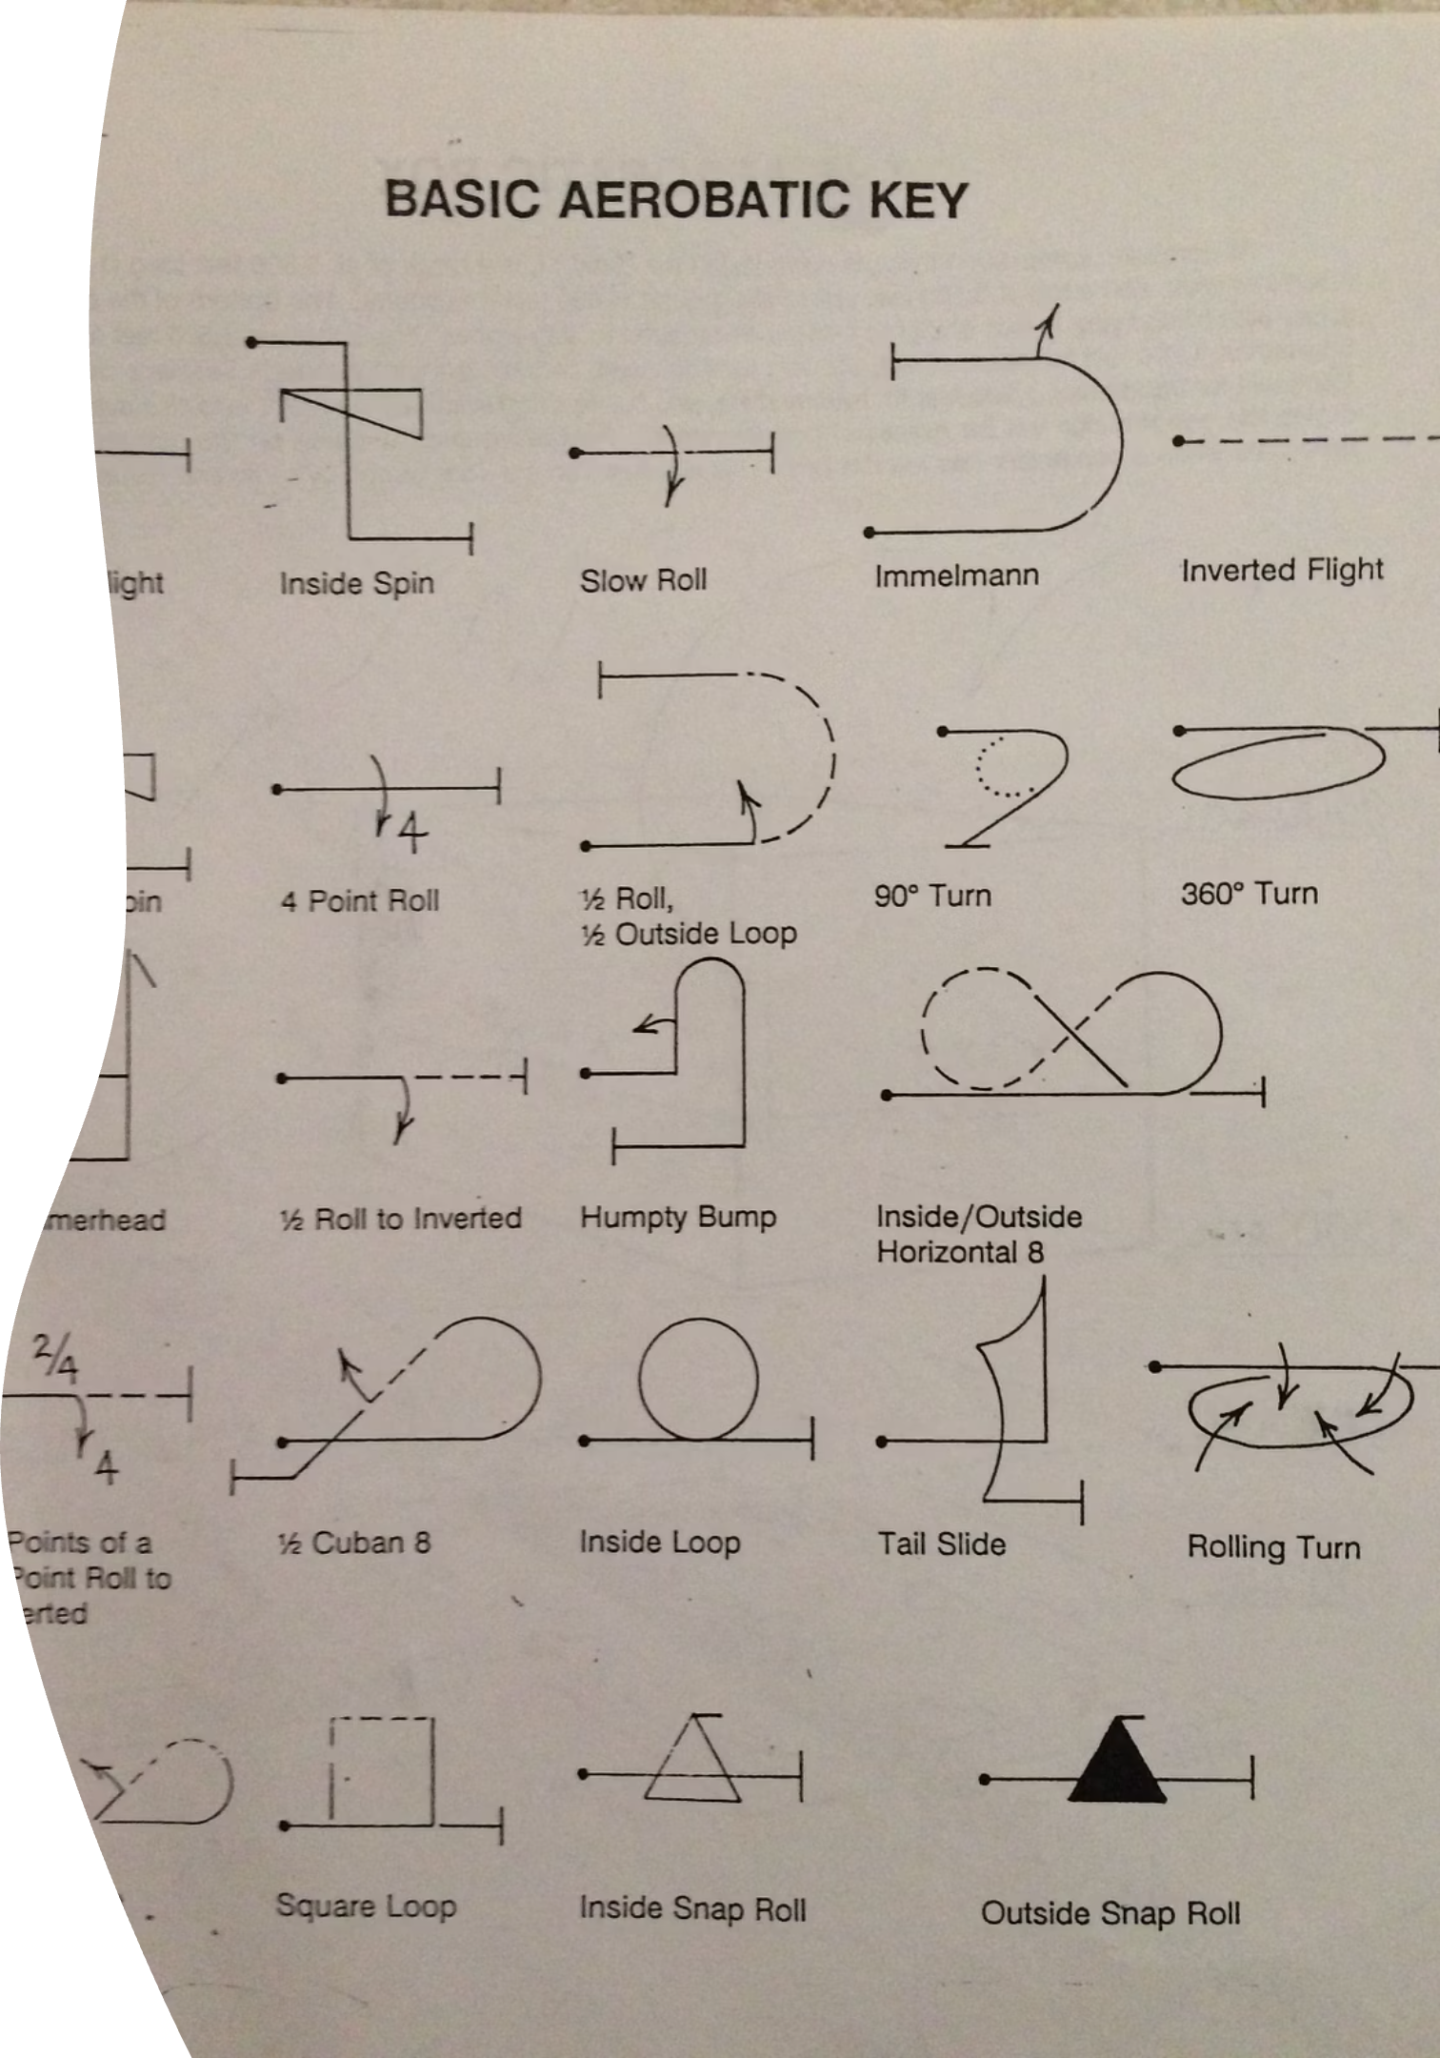
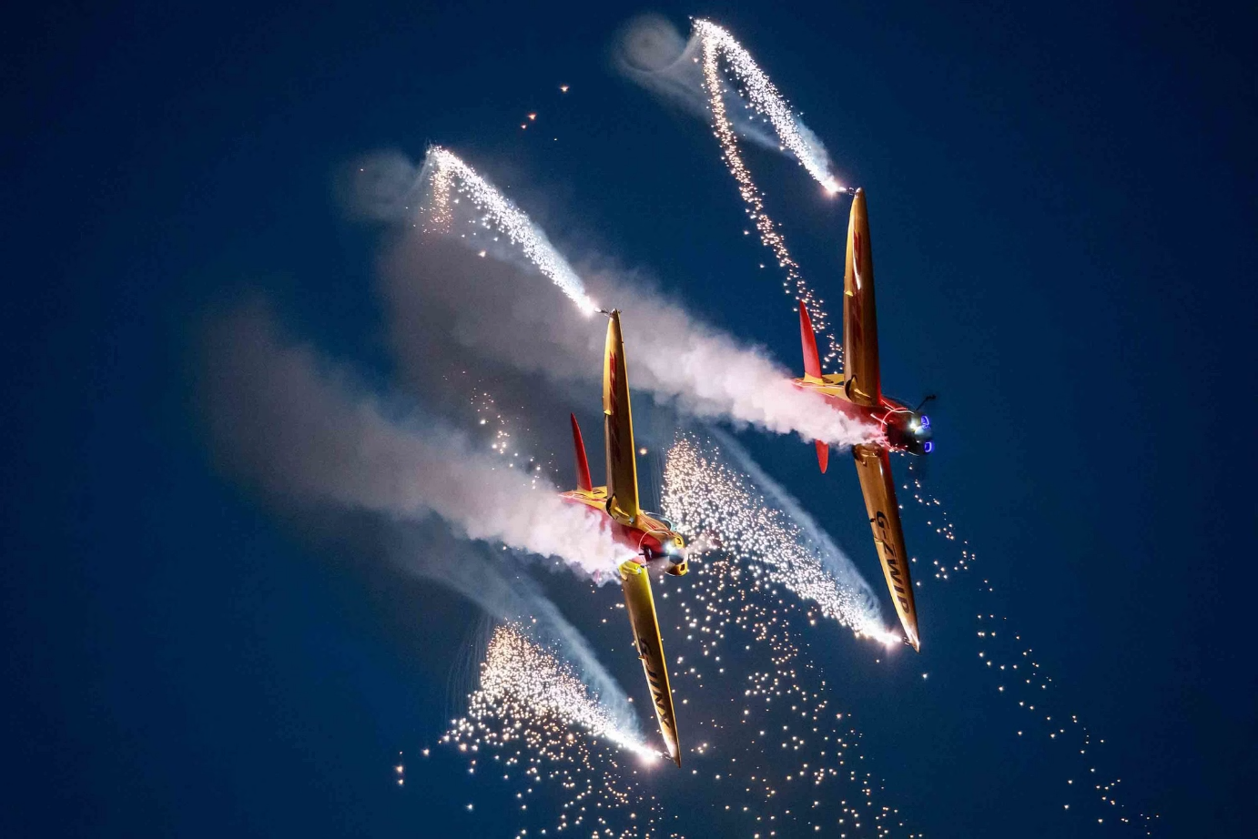
Aerobatics & Maneuvers:
The Heart of Air Shows
Iconic aerobatic figures include loops, barrel rolls, Cuban 8s, hammerhead stalls, and inverted spins.
The first loop was performed by Adolphe Pégoud in 1913, pioneering modern aerobatics.
Teams like the Blue Angels and Thunderbirds execute precise formation flying and breathtaking solo stunts.
These displays showcase exceptional pilot skill, advanced aircraft capabilities, and captivate millions globally.

Slide 6





Purpose of Air Shows
Inspire & Educate
Spark public interest in aviation and aerospace technology.
Military & Community
Support recruitment and strengthen community relations.
Industry Showcase
Promote innovations and sales within the aerospace sector.
Celebrate History
Honor aviation's past and the bravery of pilots.
Entertainment
Deliver thrilling and educational experiences for all ages.

Slide 7

Thank You!

